Slide 1
IST 659 Flight Management System using Android Application and SQLite Database
BY-
Samarth Sandesh Mengji
Shreyas Subhash Tekawade
Group Number - 45
Prof. Michael Fudge

Slide 2
Overview
This Project focuses on developing a database for managing the flight management system.
It includes numerous flight details that an administrator can host and allows application users to login and register, modify, cancel their flight bookings.
With this Project, i) we can track flight registration details of users, ii) create tickets for passengers, iii) schedule flights, modify, cancel and delete bookings for a particular user.
Additionally, the administrator can add, delete, update flights that can be seen by the user.
This feature enables the administrator to host a plethora of flights on the android application that can be accessed by the users.

Slide 3




Technology Stack

Slide 4
Goals
To build an android application for booking, modifying and cancelling flights (User End); inserting, updating, deleting and tracking flights (Admin End) using SQLite database, JDBC driver and Core Java:
Creating two separate logins for user and admin on start screen. Create two separate tables for admin tables for customers and admin for authentication.
Creating two different workflows on Android UI itself for admin and user which will involve different operations based on user.
Admin workflow will involve operations like inserting flights to database, deleting flights from database, updating/modifying flights from database, tracking flight status, viewing all flights available (Adding filter on viewing based on complexity and time constraint of project).
Customer workflow will involve operations like searching flights based on date, location, to-from, one-way/round-trip, booking flights if seats available, cancelling booked flight and view booked flight.
Write code from scratch using SQL, java, XML and android to learn new technologies along with database operations.

Slide 5
Specifications
Entity Relationship Data Requirements/Business Rules
Conceptual Data Model
Logical Data Model
Logical Design User Interface Layout
Demo of UI and Layout
Table Data

Slide 6
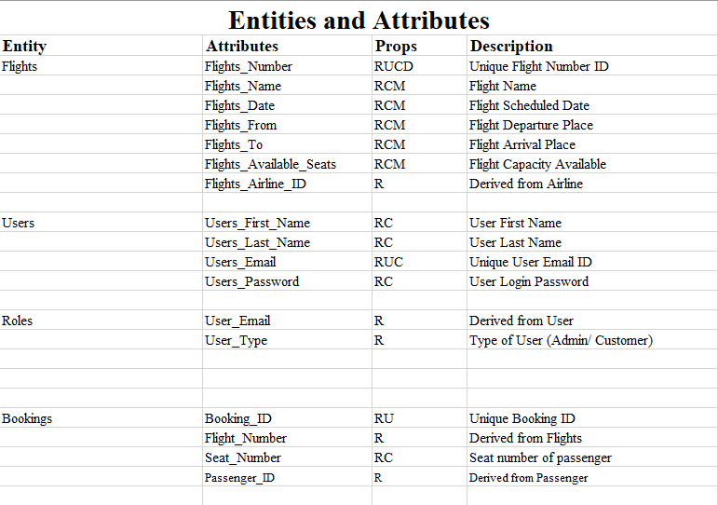
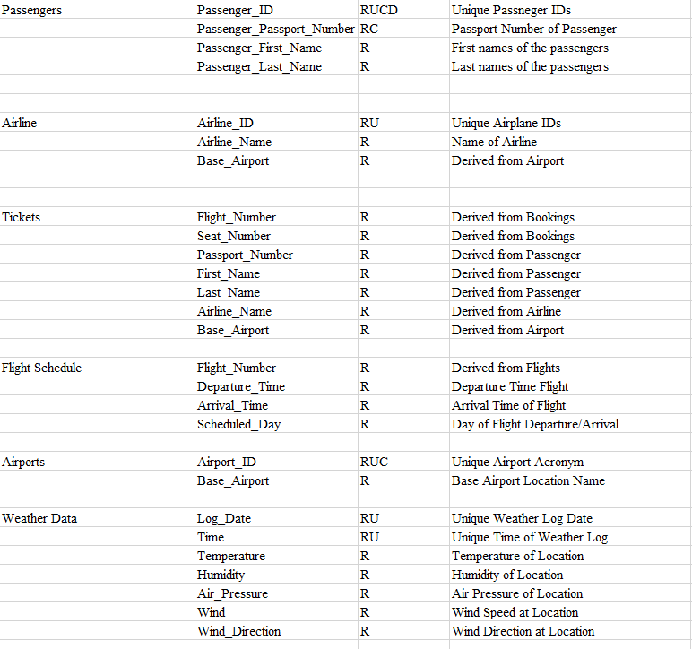
ERD Data Requirements

Slide 7
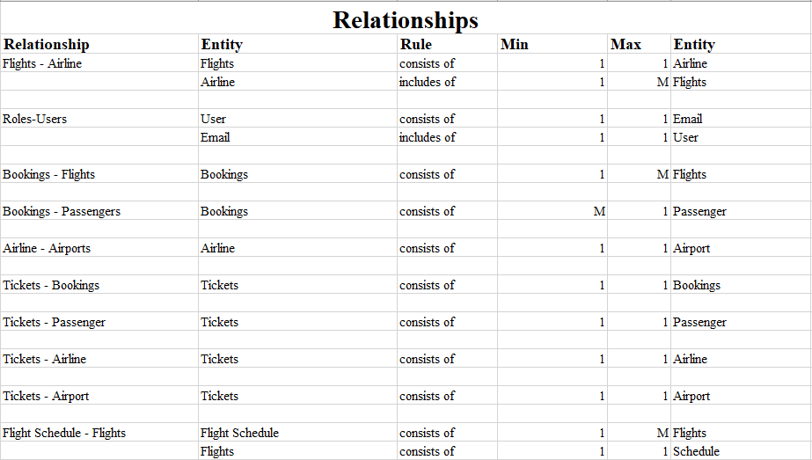
ERD Data Requirements

Slide 8
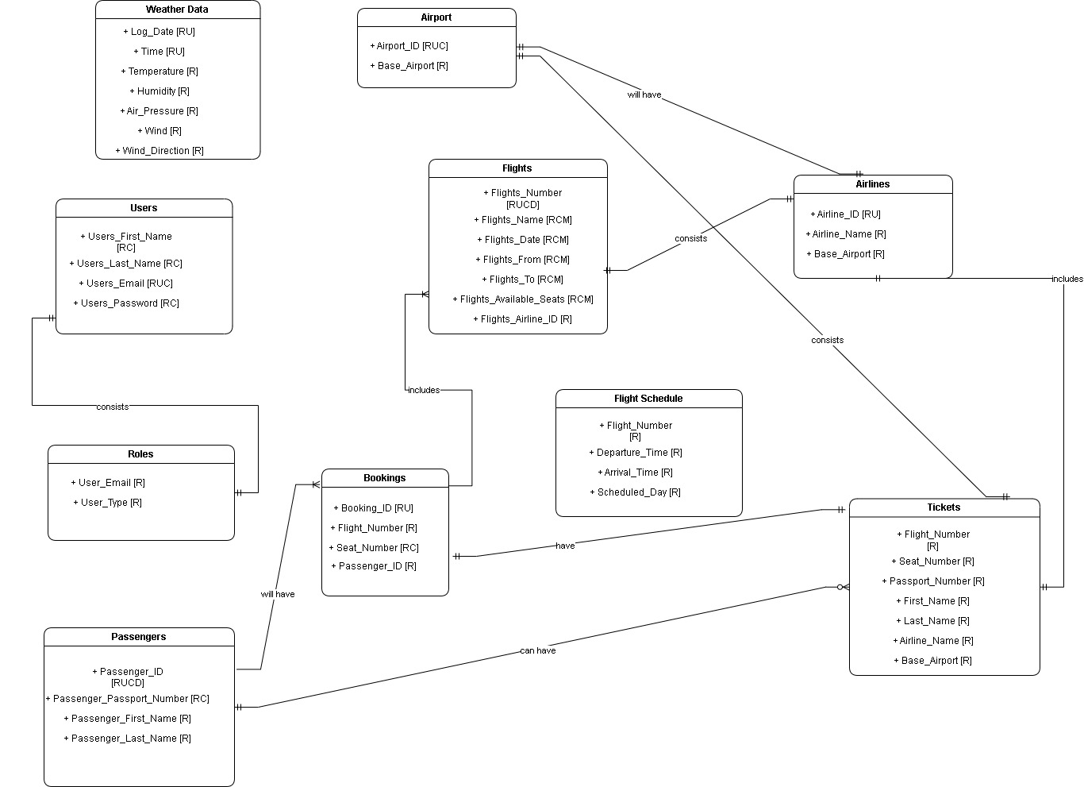
Conceptual Model

Slide 9
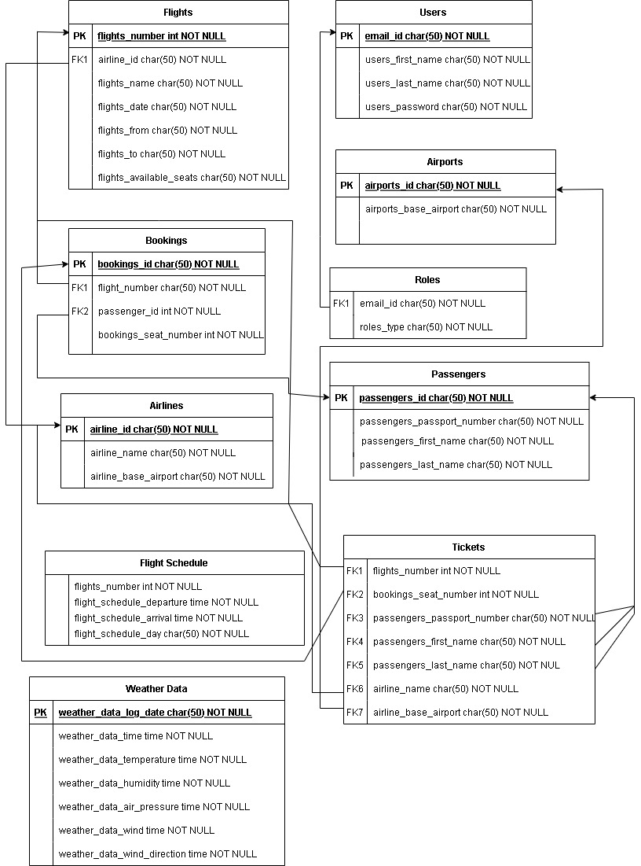
Logical Model

Slide 10
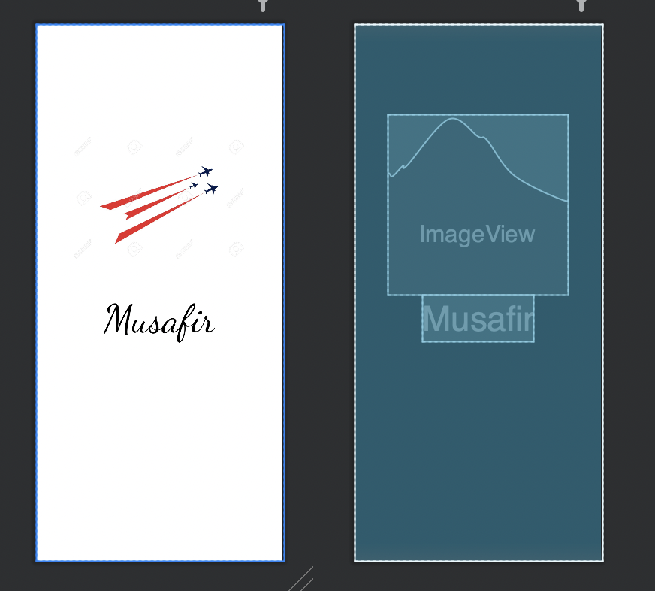
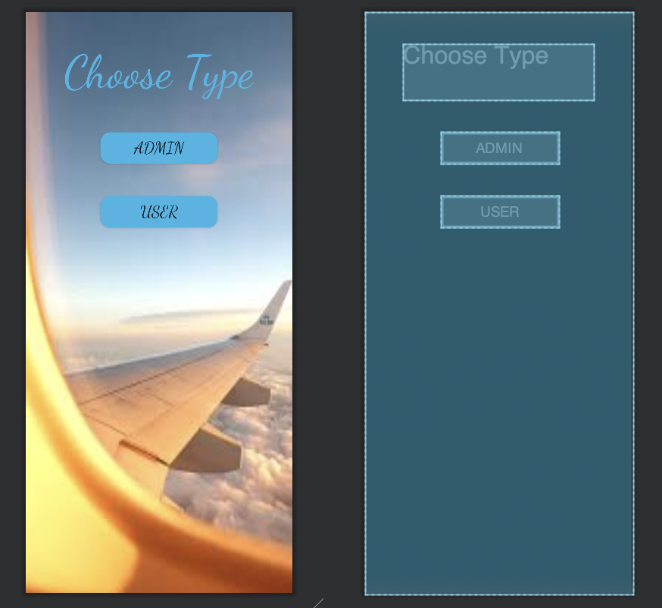
Demo of UI and Layout

Slide 11
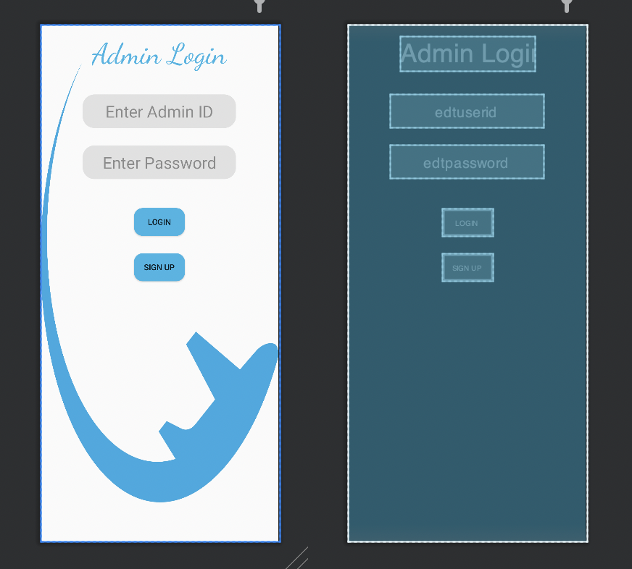
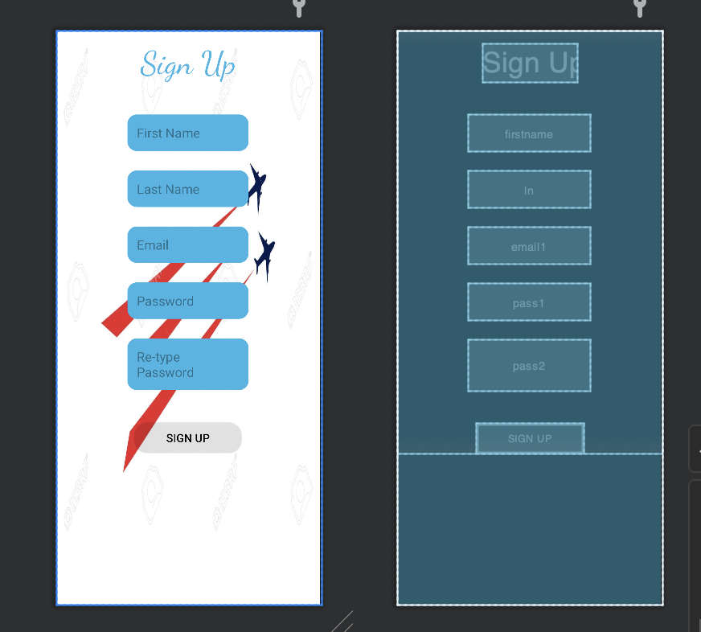
Demo of UI and Layout

Slide 12
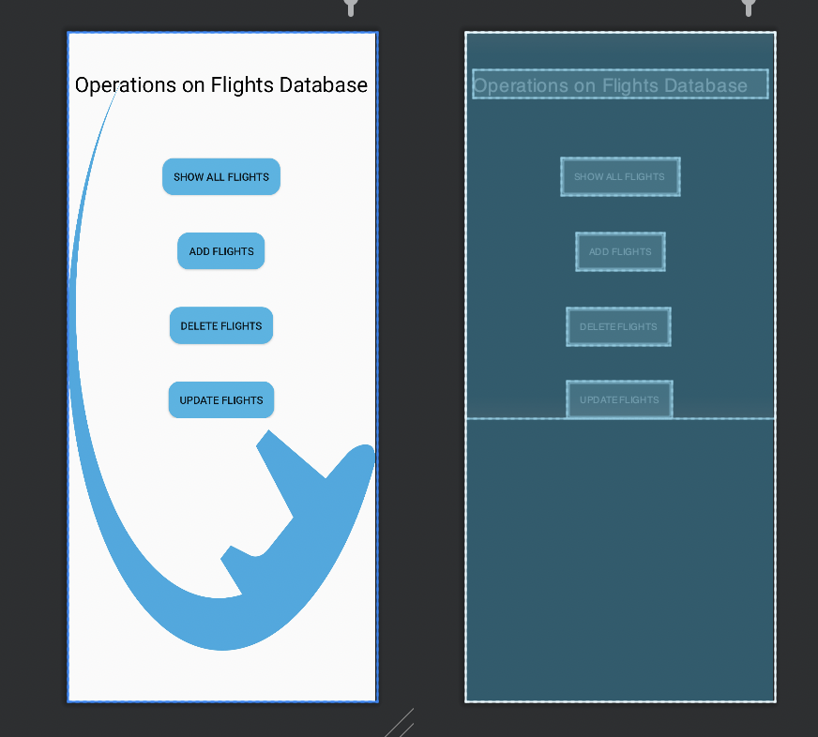
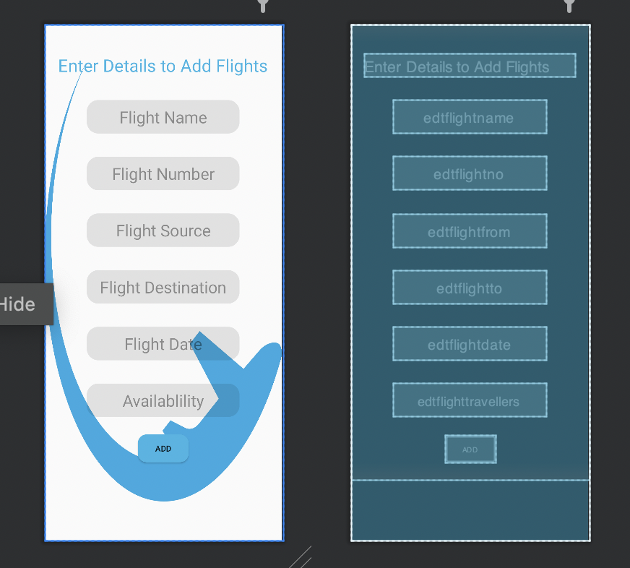
Demo of UI and Layout

Slide 13
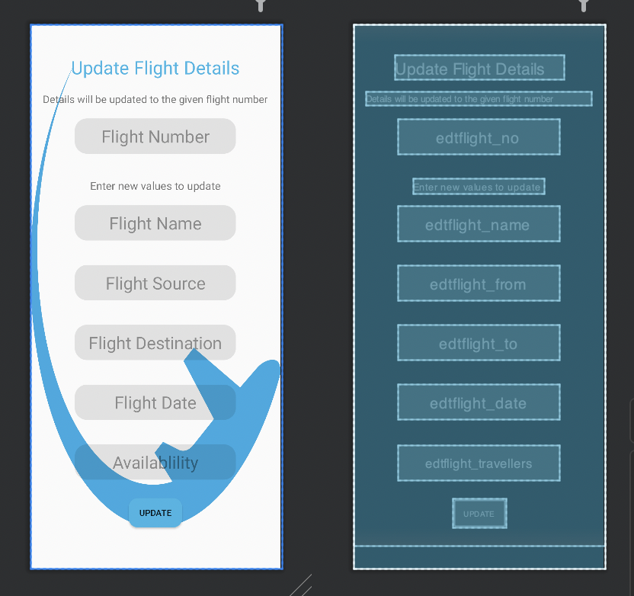
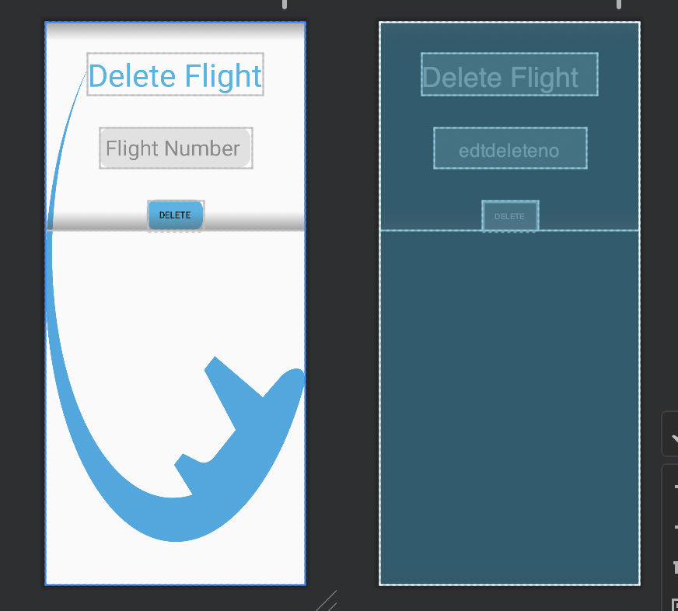
Demo of UI and Layout

Slide 14
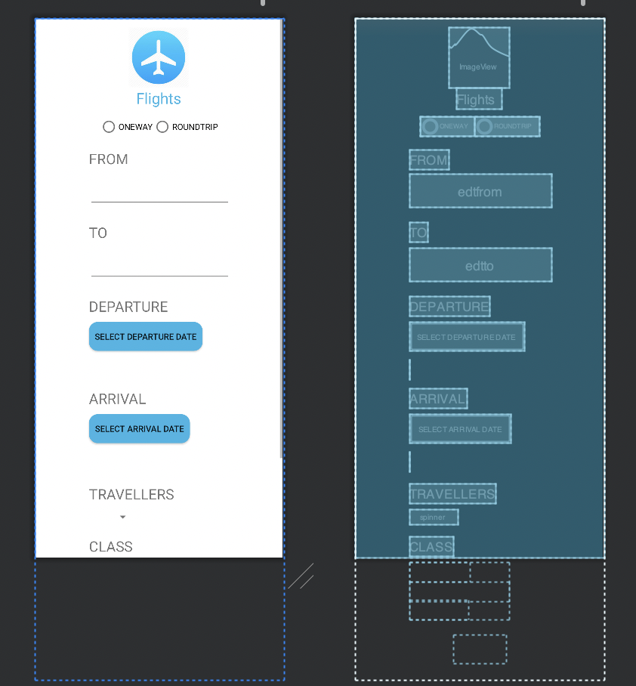
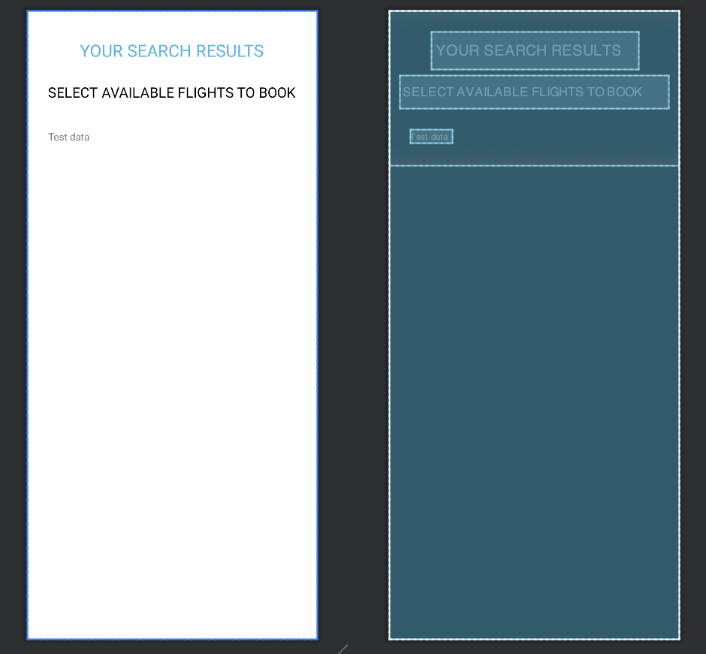
Demo of UI and Layout

Slide 15
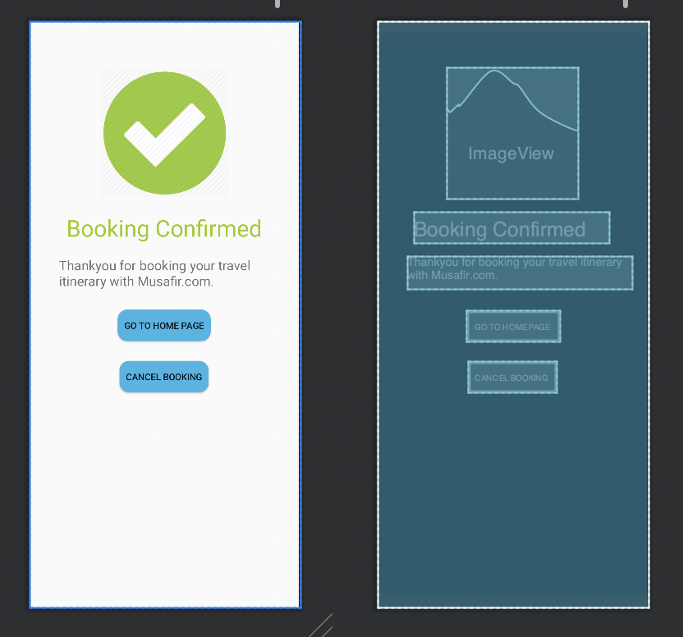
Demo of UI and Layout

Slide 16
Table Data

Slide 17
THANK YOU

